Slide 1
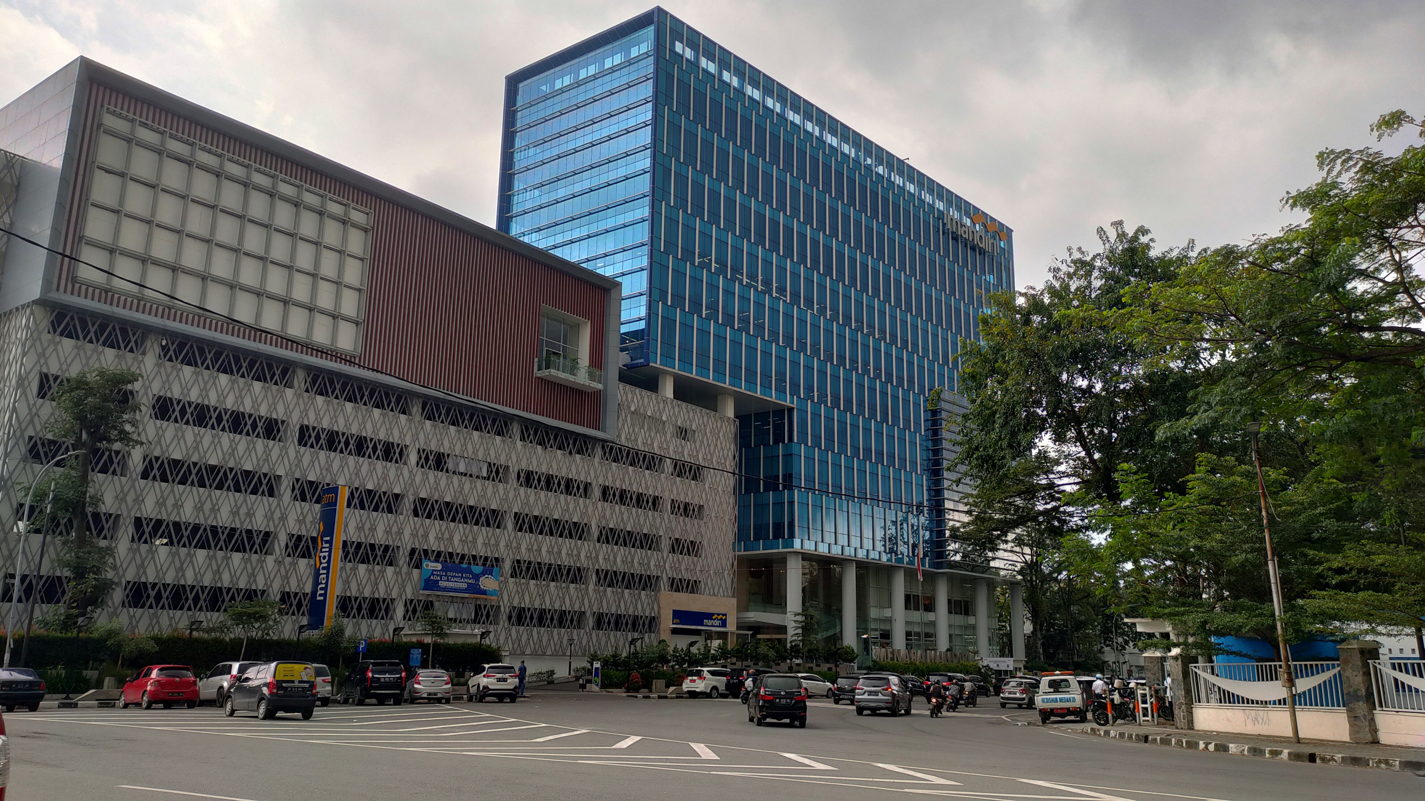
DATA SCIENCE IN BANKING
BY BIMA SAKTI NUGRAHA

Slide 2

DATA SCIENCE

Slide 3



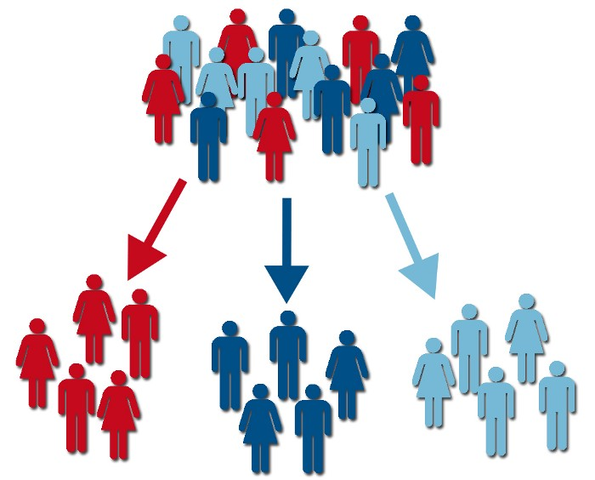




ide fitur, target market & benefit
implementation
Rp
Next Best
Offer
Churn Prediction
Income Prediction
Customer Journey
Customer Segmentation
!
Chatbot
Financial Performance Analytic
Early Warning Systems
Fraud Prevention
Data Visualization

Slide 4


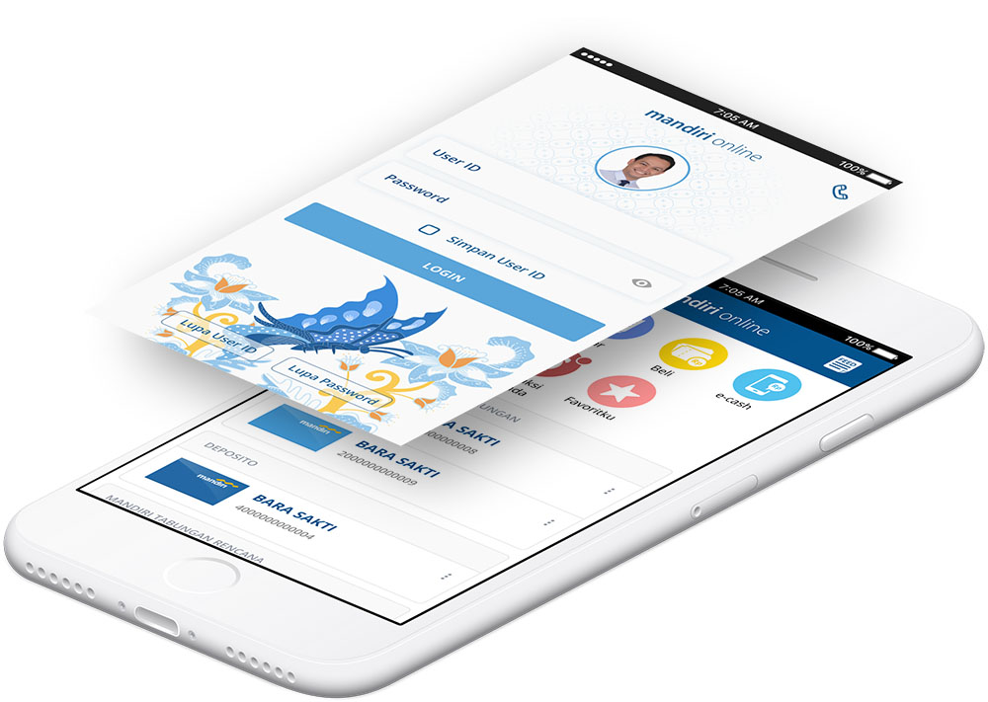


Technology approach

Slide 5
THANK YOU

